Slide 1

Big Data and Hadoop Lesson 1: Introduction to HDFS
Notes:
Welcome to the class.
We now enter the module on – Hadoop Distributed File System.
Before we start lets do a quick recap on the last module.

Slide 2


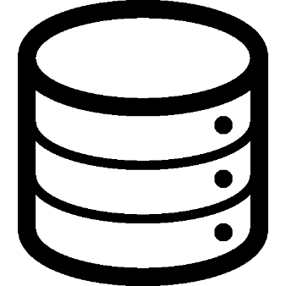


Hadoop Core Components
Distributed Data Storage frame work
Distributed Data Processing Framework
Notes:
HDFS is a Java based file system responsible for all data-storage activities in Hadoop. Its primary objective is to provide a distributed architecture for large-scale storage, which can easily be extended by scaling out. As this is a very crucial concept, I will repeat again - all the data is stored & accessed via the HDFS.
Due to its distributed architecture, it is able to scalable data storage solutions via clusters of commodity servers.
Lets go one level deeper in HDFS now.

Slide 3
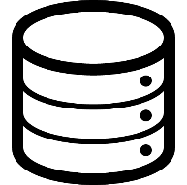
Master Slave Architecture
Secondary NameNode
Master
NameNode
DataNode
DataNode
DataNode
Slave
Notes:
HDFS is a Java based file system which follows a master-slave architecture. The name-node is the master service whereas the data-node is the slave service.
The name node is responsible for all file read & write requests ordered by the client; it keeps track of all the system meta-data.
The data node is responsible for storage; data is broken down into multiple blocks and stored in a distributed manner across the data nodes. As it is the slave; it reports to the name node by sending across periodic notifications.
The secondary name-node does not play an active role in data-storage. It acts as a back-up for the namenode wherein it periodically copies all the meta-data to its own internal storage.

Slide 4
Hadoop HDFS Daemons
NameNode: (Single instance)
Runs in Master Node
Manages the file metadata
Client connects to NameNode for initiating all reads and writes in HDFS.
Data Node: (Multiple instances/ one in each slave node)
Runs in all slave nodes
Data files are stored in the DataNodes in a distributed manner
Reports to NameNode, periodically with lists of blocks they store
Secondary NameNode:
Acts as back up node to NameNode
It periodically copies metadata into its own storage
Notes:
Please understand these 3 services very carefully as they’re essential to Hadoop. Just for extra emphasis; I will repeat them again.
Name Node:
Runs in Master Node
Manages File Metadata ie Where exactly is the file stored & how is it distributed across data-nodes.
All read & write requests from the client are processed via the name-node
Data Node
Runs is all slave nodes
Data files are stored in a distributed manner on the data-nodes local storage.
It periodically reports to the name-node with local meta-data.
Secondary Name Node
It is a back-up for the NameNode
It periodically copies meta-data from the name-node; this is stored in its local storage. If the name-node fails; this information can be pulled to restore the system.
Now lets see how all these connect together.

Slide 5
How is a File Stored in HDFS - The Process
Larger files are split into blocks, and stored in data nodes in the cluster
Each block is replicated on multiple nodes (Block replication)
Number of replications is defined in Replication Factor
Blocks are distributed across cluster in rack aware manner, to achieve data availability and fault tolerance
Metadata information is stored in NameNode, it is the master service
Notes:
At the start; the file is broken down into blocks. The default size of each block is 128MB. However, changes can be made to accommodate any variations. Then each block is replicated; the no. of times that happens is based on the replication factor; 3 is the default replication factor.
After this; it is stored in a distributed rack-aware manner across the cluster in different servers in multiple racks. All this information is stored in meta-data.
Now, what decides where exactly each file will be stored? This decision is taken by the name-node as it is the master service.

Slide 6
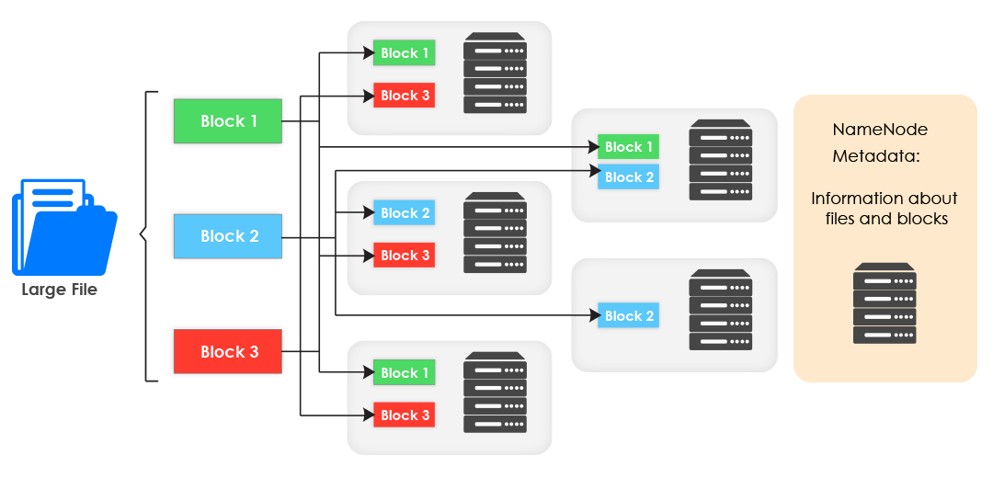
How is a File Stored in HDFS – Graphical Representation
Notes:
This is a graphical explanation featuring all the steps via which a file is stored in the HDFS.
As you can clearly see; it is first split into blocks. Then it is replicated. Then it is stored in a rack-aware manner across data-nodes. After that, this information is transferred to meta-data; which is stored in the NameNode.
As said earlier, the name-node decides where exactly in a cluster the file must be stored. Based on available MetaData, it will distribute the blocks amongst available DataNodes in a rack-aware manner.
This is the exact process of how a file is stored in the HDFS.

Slide 7
HDFS – File Write
Blocks
Checks with name node for free space
File(400mb)
HDFS
Client
NameNode
Check replication factor
Tells client where to store the data
Client transfers blocks directly to data node
Node 1
Node 2
Node 3
Node 4
DataNode
DataNode
DataNode
DataNode
Replication
Replication
Block | Size
 | 128
 | 128
 | 128
 | 16
Client request NameNode to provide which data nodes to write
Client writes block to one data node directly
Data node then forwards write request to next data node ( replication)
Cycle repeats for next block
Notes:
The following steps are involved:
When the client wants to store a file in the HDFS; he communicates with the name-node by sending a request.
The name-node checks the following
- Does this file exist or not? If yes, an error command is sent back to the client.
Does the client have permission to write? If no, an error command is sent back to the client.
Does a space-check in the system
Checks replication factor
If everything is approved, then the file loading process commences.
After this the following steps occur:
The name-node provides the available list of data-nodes in a rack-aware distribution.
Client breaks down the file into blocks which are then allocated to the data-nodes; Replication occurs in sequence.
What this means is; once a block is stored in a specific data-node, it initiates the replication process. After it is done in the next data-node; that data-node again initiates the next replication process. In this scenario, 3 is the replication factor. Once this process is complete; a notification is passed to the client.
This cycle repeats until all blocks are written to the HDFS.

Slide 8
HDFS – File Read Overview
HDFS
Client
Name Node
File(400mb)
B1
B2
B3
B4
Namenode returns location of blocks of file
Stream blocks from data nodes
DN1
DN2
DN3
DN4
B3
B2
B1
B3
B1
B2
B1
B2
B3
B1
B2
B4
Block | Size
 | 128
 | 128
 | 128
 | 16
Client receives list of data nodes for each block. NameNode provides rack local nodes first
Picks the first data node for each block
Reads blocks sequentially
B1
B2
B3
B4
Notes:
Lets move on to the decoding the file-read process. At the start, we’ll show you a high-level process. This will be followed by a deeper explanation.
The file read process; the following steps are involved; please note this can only take place after a file has been written.
The user gives a read command to HDFS client.
The HDFS client communicates with NameNode for block meta-data information for the required file.
The client gets list of data-nodes for each file-block.
The rack with maximum blocks is supplied first; followed by others racks with lesser blocks in a descending order.
Now, the client has complete information regarding the file distribution across data-nodes.
Next.
Client picks up the first data-node for each block. In this diagram; for B1 it is DN1.
The NameNode decides which data-node is DN1, DN2 and so on.
The Client reads the complete file in a parallel manner from all the data-nodes.
For example, it will read B1 from DN1, B2 from DN2 and B3 from DN3.

Slide 9
Notes:
See you in the next lesson. Thank you.

